Slide 1
FileKommander
Neha Moharir ,Jake Dsouza
nmoharir@students.poly.edu
jdsouza01@students.poly.edu

Slide 2
GATE SETTINGS
All the keywords needed to process the input are divided into
  Objects(File/Directory/Phrase)
  Actions(Create/Delete/Rename etc.)
Different list files are created for different objects and actions which lists all the possible synonyms.
Created a list file for each action.

Slide 3
JAPE RULES
FILES
  With or without quotes.
  Complex names (“docA_B-C.txt”).
  Files with extensions of length 3 or 4
Directories
  Named in double quotes
  Full or abstract/relative path name is considered
Phrases
  Named in double quotes
Actions
  Single rule to get action type.
Positions and Repetitions
  Positions (before, after, start, end etc.)
  Repetitions (every , first , last etc.) are also captured.
finalCleanup.jape combines all the annotation sets used in the project to a single set for each sentence.

Slide 4
Running Procedure
System initializes gate and creates the pipeline.
ANNIE is initialized
System then starts a new thread to listen to user input
Swing GUI to take user input thru keyboard and microphone
On User Input and submit , annotations are generated
For each sentence in input , the sentence is analyzed to get the action and objects and an appropriate ActionModel is created
The ActionModel is then processed to run the specific action which is then displayed on GUI

Slide 5
IMPLEMENTED FEATURES
Create – Single or multiple files and folders
Delete – Delete single or multiple files and folders
Rename – Rename a file/folder with new name
Statics – Get information about files or folders
  Exists
  Last Modified
  List files in a folder
  Count of words in a file
  Count of files in a folder
Open – Open a file with system editor. OS independent (works on Win/Mac/*nix) systems
Insert/Remove/Replace phrases in a file
Errors during processing are displayed on screen or in tooltips

Slide 6
UNIMPLEMENTED FEATURES
Operations not implemented
  Close file
  Regular Expression for insert replace operations
  Regular Expression for delete operations
Speech recognition is dependent on Google Chrome Speech API and is not usable for file names and special characters.
Ability to modify options dynamically during runtime

Slide 7
Speech Recognition
We have used a Java-Speech-API library for speech recognition.
It uses the speech engines created by Google to provide functionality for parts of the API.
Speech captured by system is encoded to FLAC and sent as a post request to Google which replies with a JSON object giving possible text and confidence
It uses a recognizer, synthesizer and microphone capture utility.
It makes use of Google services for recognizer and synthesizer.

Slide 8
VERSION 0.002 – IN FUTURE
In the future, this application can be more interactive with the user.
Implement speech recognition.
To change the properties of the application, e.g. the working directory, GATE path, etc. at runtime.
Show a progress bar while the operations are being done.
Make code more modular so that users can add more actions and features
Run the program as a service in the background waiting for global hot key . Display the user interface on some key combination which will disappear when action is complete

Slide 9
REFERENCES
http://gate.ac.uk/
https://github.com/The-Shadow/java-speech-api
http://commons.apache.org/io/
http://commons.apache.org/lang/
http://logging.apache.org/log4j/1.2/

Slide 10
Source Code
http://goo.gl/JBYog

Slide 11
Demonstration
A working program is one that has only unobserved bugs.
It's not a bug, it's an undocumented feature.
The probability of bugs appearing is directly proportional to the number and importance of people watching.

Slide 12
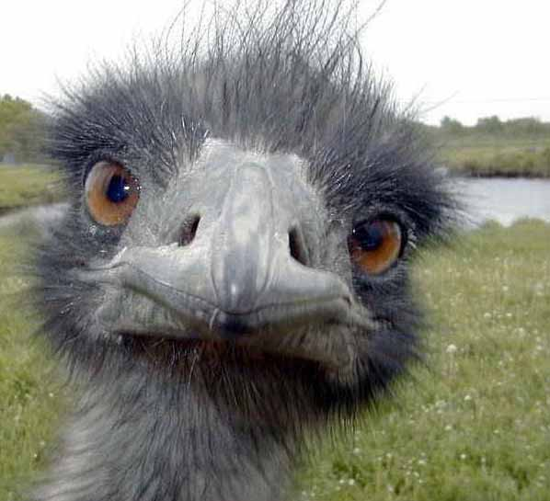
Questions ?

